Slide 1
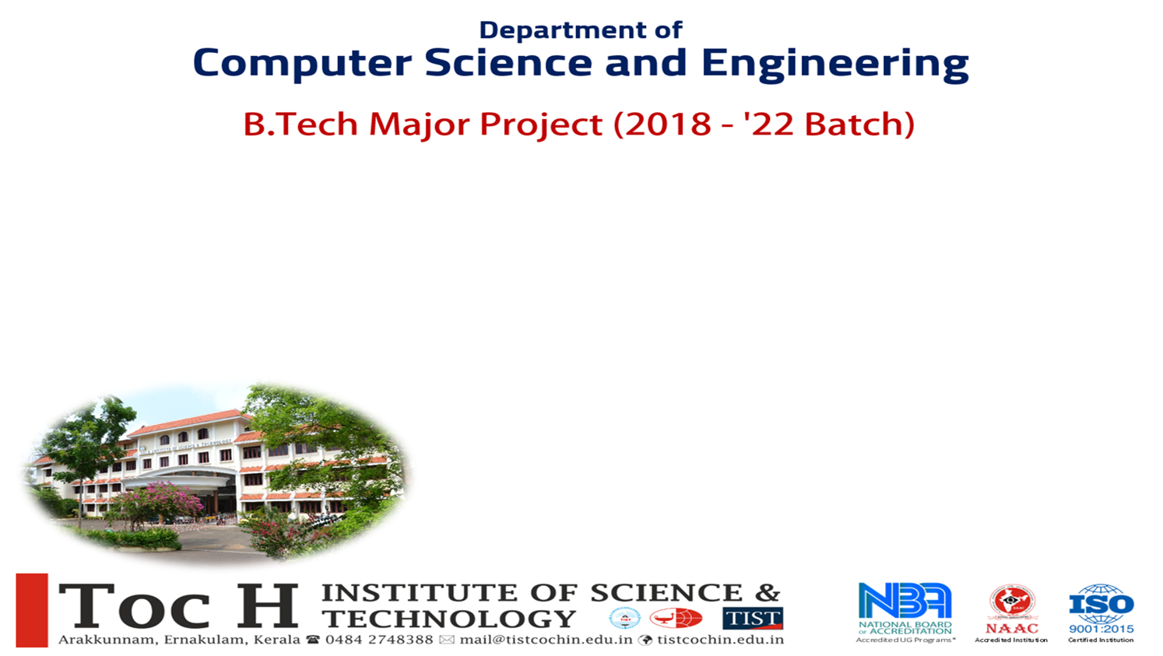
DEPARTMENT OF COMPUTER SCIENCE & ENGINEERING
B.TECH MINI PROJECT (2022-2026 BATCH)
LegalEase
Project Team:
MEYA MARIA TONY(TOC22CS096)
SREEYA MENON P T(TOC22CS115)
GOPIKA SHAJU(TOC22CS076)
SRUTHY RAVI(TOC22CS116)
Project Guide:
MS.CHINTU P CHACKO

Slide 2
TABLE OF CONTENTS
INTRODUCTION
LITERATURE REVIEW
PROBLEM DEFINITION
PROBLEM STATEMENT
PROPOSED SYSTEM
SYSTEM DESIGN
MODULE DESCRIPTION
IMPLEMENTATION DETAILS
RESULTS AND TESTING
FUTURE SCOPE
CONCLUSION
REFERENCES

Slide 3
1)INTRODUCTION
Legal systems in India are complex and often require expert guidance, but many individuals cannot afford legal representation and seek self-representation.
AI-powered solutions can bridge this gap by providing legal guidance based on existing laws, improving access to justice for those who struggle with legal literacy and face language barriers in accessing legal information.
AI can efficiently retrieve case laws, provide summaries, making legal assistance more accessible and automated.
Developing an AI-powered legal assistant that answers queries in English & Malayalam can support users with legal research, case law retrieval, and legal predictions.
This initiative aligns with the Indian judicial system’s digital transformation, supports self-representing individuals, and reduces the burden on legal professionals by automating repetitive tasks.

Slide 4

2)LITERATURE REVIEW

Slide 5
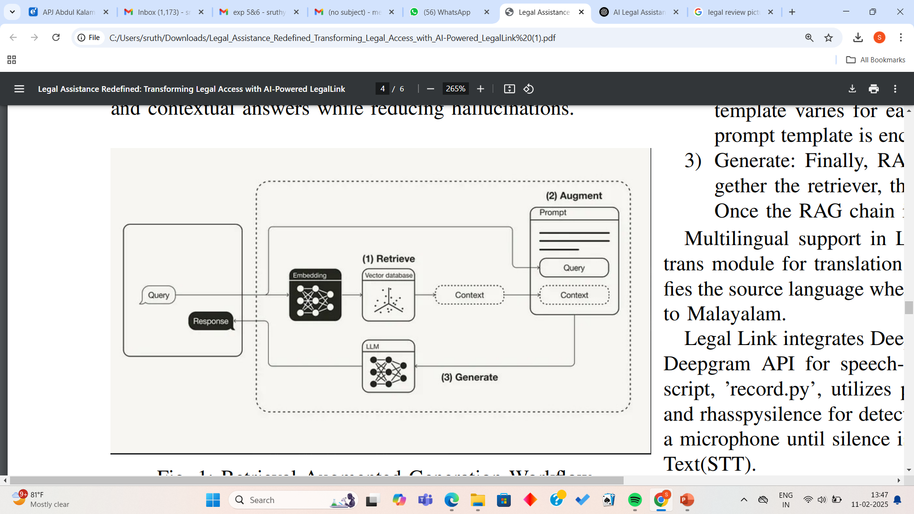
RESEARCH PAPER 1
Legal Assistance Redefined: Transforming Legal Access with AI-Powered LegalLink by Susan Jacob , Prisly Mary Jacob , Jo Cheriyan , Safad Ismail
The research paper presents LegalLink, an AI-driven system designed to improve access to legal information and streamline legal processes for law professionals. The core objective is to reduce manual legal research time and enhance response accuracy using advanced technologies such as Natural Language Processing (NLP), Knowledge Graphs(Helps in connecting related legal concepts and delivering contextually appropriate results), Machine Learning (ML), and Retrieval-Augmented Generation (RAG).
Retrieval-Augmented Generation Workflow
LegalLink primarily caters to law firms and legal professionals rather than the general public, making legal research more efficient and document management more reliable.

Slide 6
RESEARCH PAPER 1(cont.)
KEY FEATURES:
Retrieval-Augmented Generation (RAG)
NLP-Powered Legal Q&A Chatbot
Document Summarization
Data Security Mechanisms
IMPORTANCE:
Efficiency for Legal Professionals
Improved Accuracy
Enhanced Document Management
Accessible Knowledge Base

Slide 7
RESEARCH PAPER 1(cont.)
Advantages:
Higher Accuracy
Legal Document Processing
Automated Statute Lookup
Summarization
Legal Automation

Slide 8
RESEARCH PAPER 1(cont.)
Disadvantages:
English Only
No Outcome Predictions: Unlike Legalease, it doesn’t predict legal outcomes for case assessment.
Limited Accessibility
Text-Only Input

Slide 9
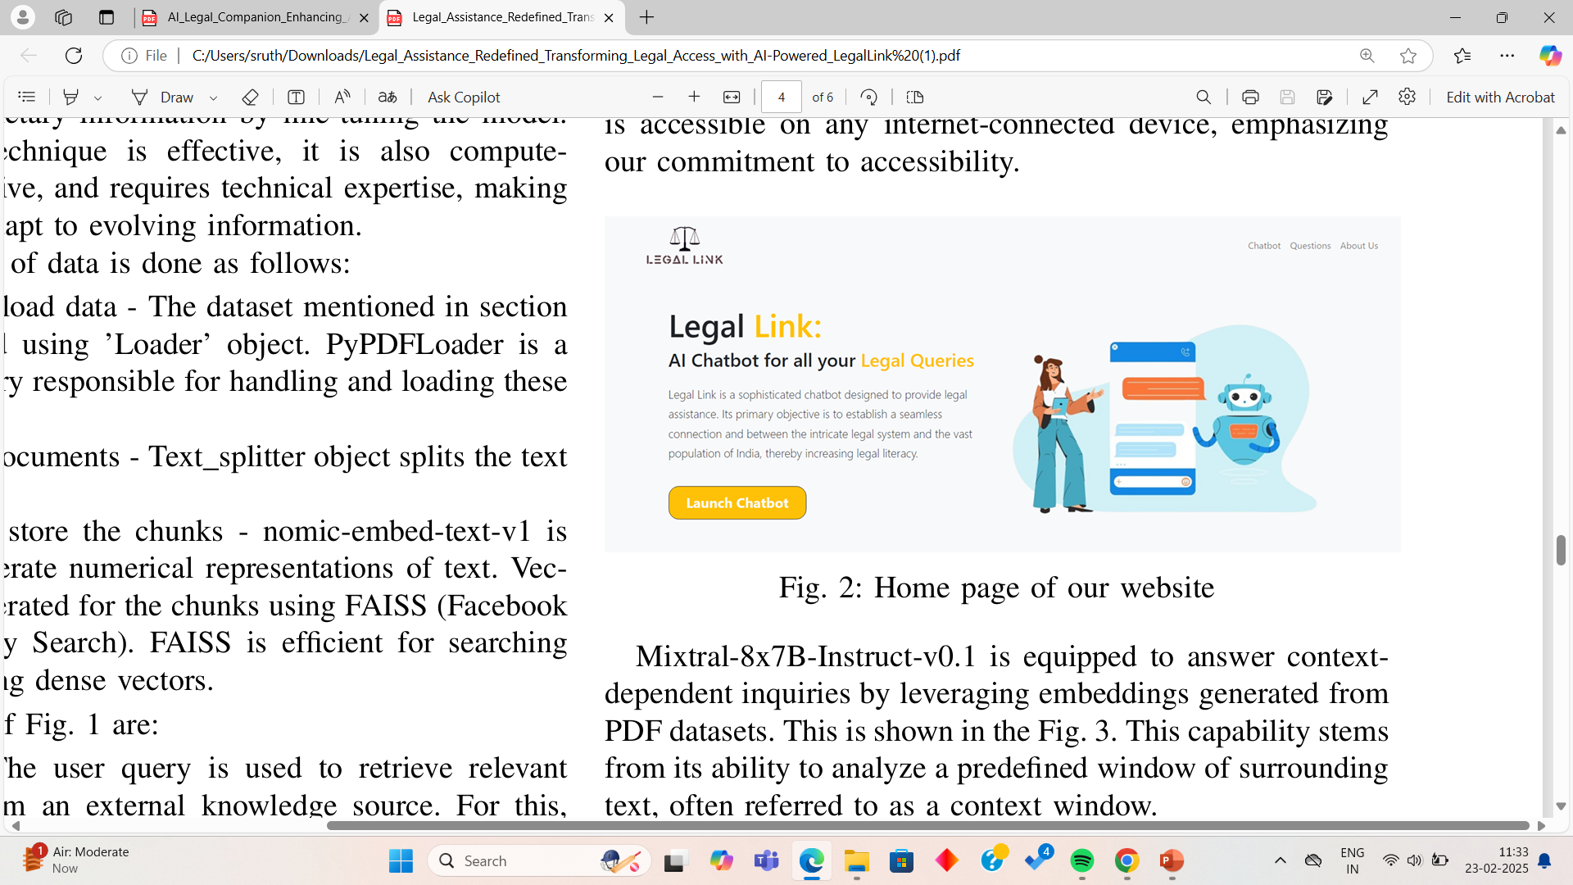
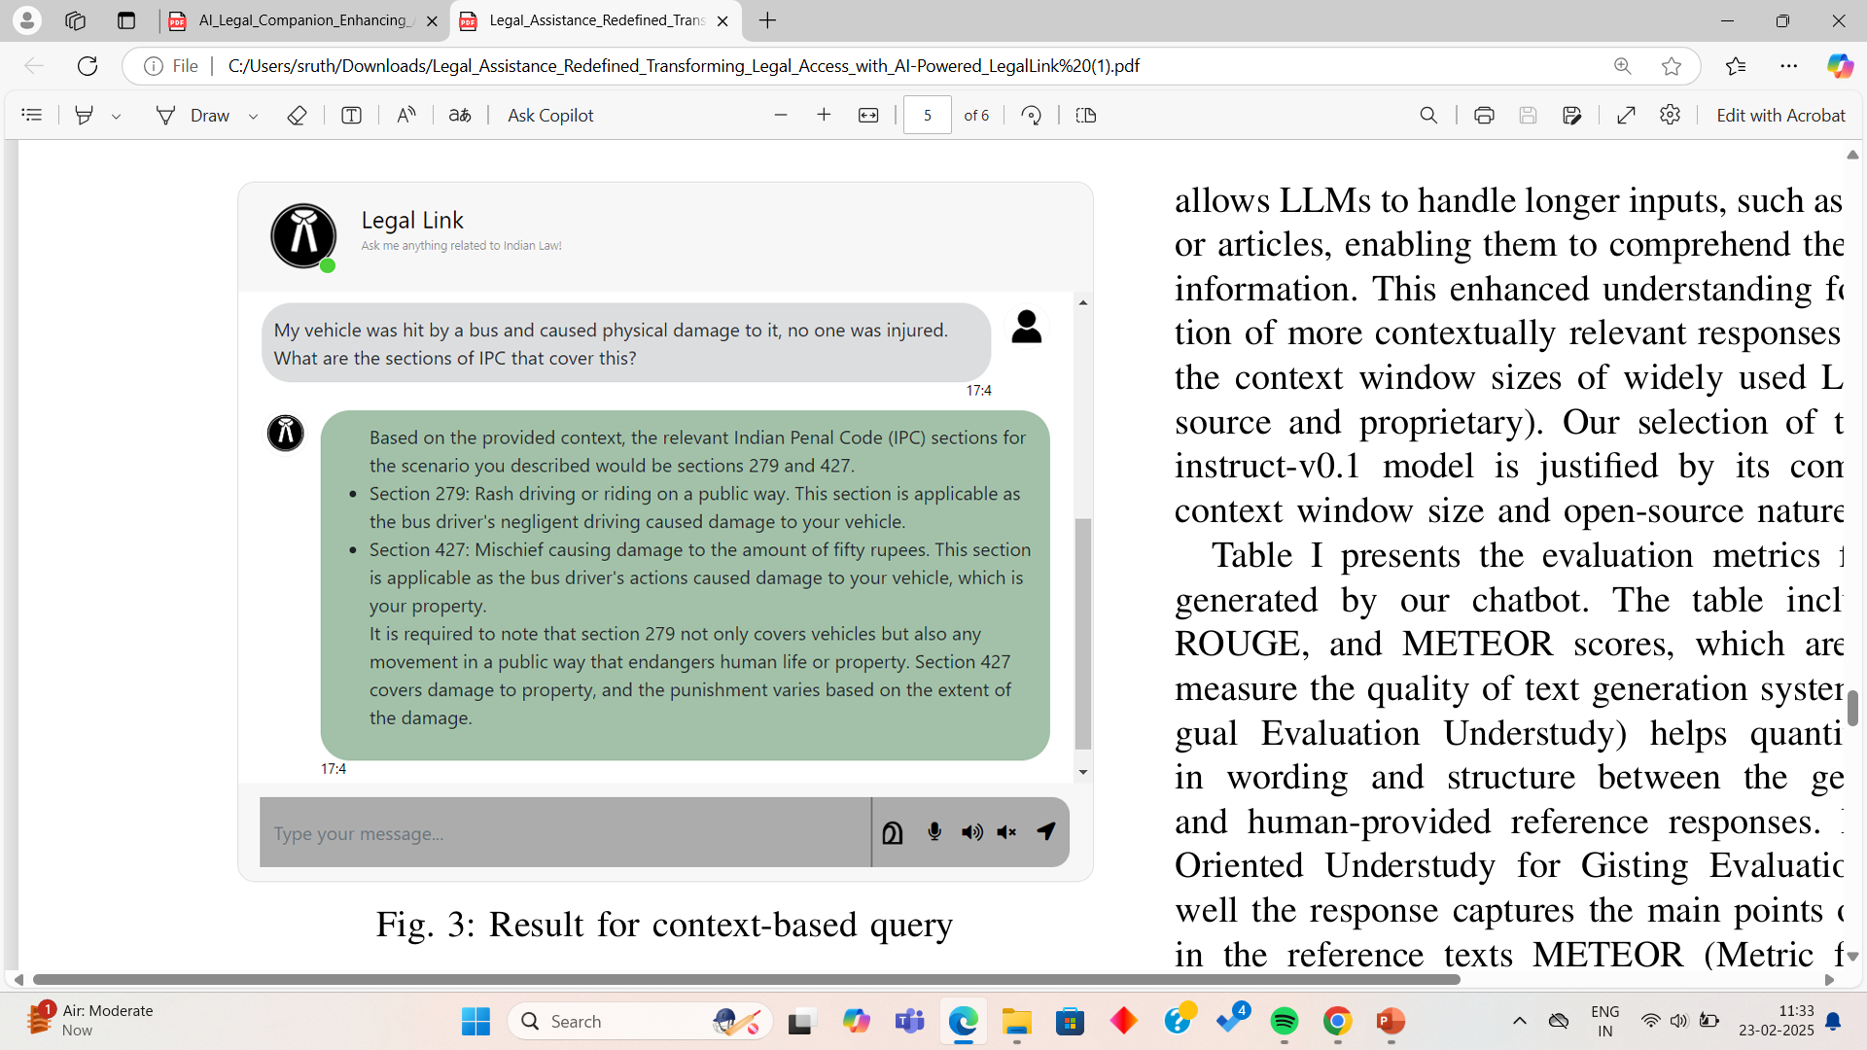
RESULT

Slide 10
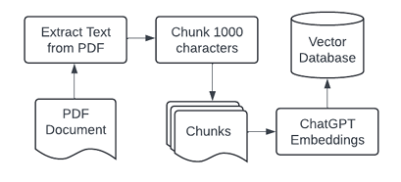
RESEARCH PAPER 2
AI Legal Companion: Enhancing Access to Justice and Legal Literacy for the Public by Donny Kurniawan , Siti Elda Hiererra
The AI Legal Companion research paper presents a legal AI assistant designed to improve access to justice by enhancing legal literacy for the general public. The system utilizes Natural Language Processing (NLP), Machine Learning (ML), and Retrieval-Augmented Generation (RAG) to simplify complex legal concepts.The development of an AI Legal Companion web application involves several key steps: preparing external knowledge, web app design(the backend handles data retrieval and AI interactions, while the frontend manager user chats),RAG process
AI legal companion primarily serves non-lawyers by explaining legal terms, procedures, and rights in a simplified and accessible manner. It acts as an interactive guide to help individuals understand their legal standing without requiring professional legal assistance.
Prepare External Knowledge

Slide 11
RESEARCH PAPER 2(cont.)
KEY FEATURES:
Retrieval-Augmented Generation (RAG)
Legal Knowledge Graph
Interactive Chatbot Interface
Context-Aware Responses
Simplified Legal Content Presentation
IMPORTANCE:
Promotes Legal Literacy
Bridges the Justice Gap
Improves Public Access to Justice
Time-Efficient Legal Assistance

Slide 12
RESEARCH PAPER 2(cont.)
Advantages:
Accessible Legal Knowledge
Context-Aware Accuracy
User-Friendly Interaction
Continuous Learning Mechanism
Wide Public Appeal

Slide 13
RESEARCH PAPER 2(cont.)
Disadvantages:
Monolingual Interface
No Legal Outcome Prediction
No Voice Input Support

Slide 14
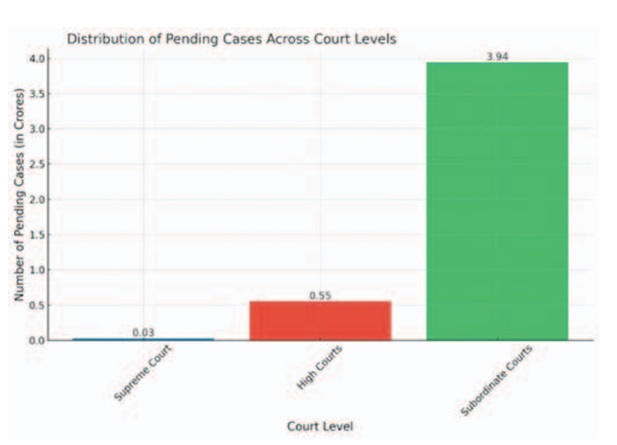
RESEARCH PAPER 3
Bettercall: AI based legal assistant by Manikrao Dhore , Aryan Vimal, Avish Agrawal, Raghav Bajaj, Rohan Barde
The BetterCall AI-Based Legal Assistant is a research paper that introduces an NLP-powered legal assistant designed to retrieve legal information and assist in case law analysis. The system aims to simplify legal research for professionals through semantic search capabilities and interactive chatbot functionality.
It uses technologies such as Natural Language Processing (NLP), Word Embedding Models, Chatbot Framework, Database Integration.

Slide 15
RESEARCH PAPER 3(cont.)
KEY FEATURES:
Natural Language Processing (NLP)
Semantic Search with Word Embeddings
Interactive Chatbot Interface
Case Law Retrieval
Document Similarity Analysis
IMPORTANCE:
Simplifies Legal Research
Reduces Time & Effort
User-Friendly Interface
Improves Legal Decision-Making

Slide 16
RESEARCH PAPER 3(cont.)
Advantages:
Intuitive Query System
Efficient Legal Document Retrieval
Interactive Chatbot Assistance
Time-Efficient Search Mechanism
Simplified Document Analysis

Slide 17
RESEARCH PAPER 3(cont.)
Disadvantages:
Monolingual Interface
No Case Outcome Prediction
No Sentiment Analysis
Professional-Oriented Design

Slide 18
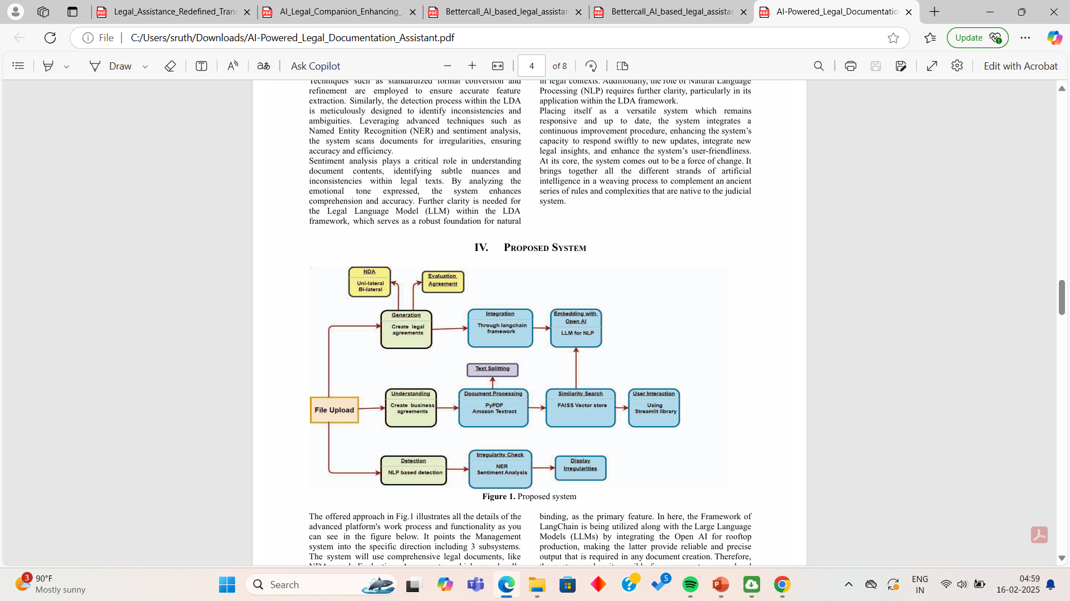
RESEARCH PAPER 4
AI-Powered Legal Documentation Assistant by Kuldeep Vayadande, Aditi Bhat, Pranav Bachhav, Aditya Bhoyar, Zulfikar Charoliya, Aayush Chavan
The research paper on AI-Powered Legal Documentation Assistant presents an innovative solution designed to streamline legal documentation processes using Artificial Intelligence (AI) and Natural Language Processing (NLP). The primary focus is to improve the accuracy and efficiency of document handling in legal firms and corporate legal departments by automating document processing, error detection, and content summarization.
It include technologies such as Natural Language Processing (NLP), Machine Learning Algorithms, PyPDF & Amazon Textract, LangChain Framework, Semantic Search with Embedding Models.

Slide 19
RESEARCH PAPER 4(cont.)
KEY FEATURES:
Document Parsing and Extraction
Text extraction tools like PyPDF and Amazon Textract are utilized for efficient data extraction from PDFs.
Automatic Error Detection
Document Summarization
Template-Based Document Generation
Intelligent Document Search
IMPORTANCE:
Enhanced Document Accuracy
Time Efficiency
Cost Reduction
Improved Legal Compliance

Slide 20
RESEARCH PAPER 4(cont.)
Advantages:
High Document Processing Accuracy
Increased Efficiency
Real-Time Document Summarization
Error Detection & Prevention

Slide 21
RESEARCH PAPER 4(cont.)
Disadvantages:
Language Limitations - Only supports English
Lack of Legal Advisory Features
No Legal Outcome Prediction
Text-Only Interface

Slide 22
summary

Slide 23
Sl.NO | Paper Name | Published Year | Author Name | Pros | Cons
1. | Legal Assistance Redefined: Transforming Legal Access with AI-Powered LegalLink | 2024 | Susan Jacob , Prisly Mary Jacob , Jo Cheriyan , Safad Ismail | High accuracy with RAG integration. Automated document summaries. | English-only interface. No case outcome prediction. No voice input support. Efficient legal research for professionals.
2. | AI Legal Companion: Enhancing Access to Justice and Legal Literacy for the Public | 2024 | Donny Kurniawan , Siti Elda Hiererra | RAG-powered for better accuracy. Educational and interactive interface. | No multilingual support. Lacks case prediction and sentiment analysis. No voice input functionality.
3. | Bettercall: AI based legal assistant | 2024 | Manikrao Dhore , Aryan Vimal, Avish Agrawal, Raghav Bajaj, Rohan Barde | Fast legal document retrieval with NLP. | Monolingual (English-only). No outcome prediction or sentiment analysis. Lawyer-focused, not public-friendly.
4. | AI-Powered Legal Documentation Assistant | 2024 | Kuldeep Vayadande, Aditi Bhat, Pranav Bachhav, Aditya Bhoyar, Zulfikar Charoliya, Aayush Chavan | Automated document parsing and summarization. Error detection for legal documents. Simplifies legal documentation tasks. | No legal advisory functionality. English-only text processing. No case outcome prediction.

Slide 24
3)PROBLEM DEFINITION​
Legalease is an AI-driven platform designed to bridge the gap between legal knowledge and public access. It utilizes Natural Language Processing (NLP) and Machine Learning (ML) to deliver personalized legal assistance. The system will:
Answer legal queries with text and voice-enabled chatbot support.
Retrieve case laws and statutes from Indian Penal Code (IPC) databases.
Provide multilingual support in English and Malayalam, enhancing accessibility for diverse user groups.
By combining cutting-edge AI capabilities with practical legal functionalities, Legalease aims to democratize access to justice and simplify legal processes for the general public.

Slide 25
4)PROBLEM STATEMENT​
Accessing legal information in India is a daunting challenge due to complex legal language, limited multilingual resources, and expensive legal services. Legalease is an AI-powered legal assistant that simplifies legal guidance by offering case law retrieval, legal predictions, and real-time assistance through text and voice inputs in English and Malayalam. It aims to empower individuals, especially those self-representing in court, by providing reliable, accessible, and affordable legal support.

Slide 26
5)PROPOSED SYSTEM​
LegalEase is an AI-driven legal document classification and assistance system that employs Supervised Learning to enhance the efficiency of legal research and document management. The system provides language translation (English & Malayalam) and voice-based interactions, ensuring accessibility for a diverse range of users.
Key Features
Multi-Language Support: Allows users to switch between Malayalam and English dynamically.
Voice-Enabled Search & Query Processing: Enables voice input for legal queries in both languages.
User-Friendly UI/UX:Easy navigation for both legal professionals and general users

Slide 27
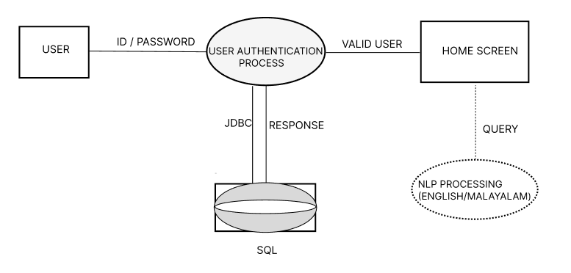
6)SYSTEM​ DESIGN
ARCHITECTURE DIAGRAM

Slide 28
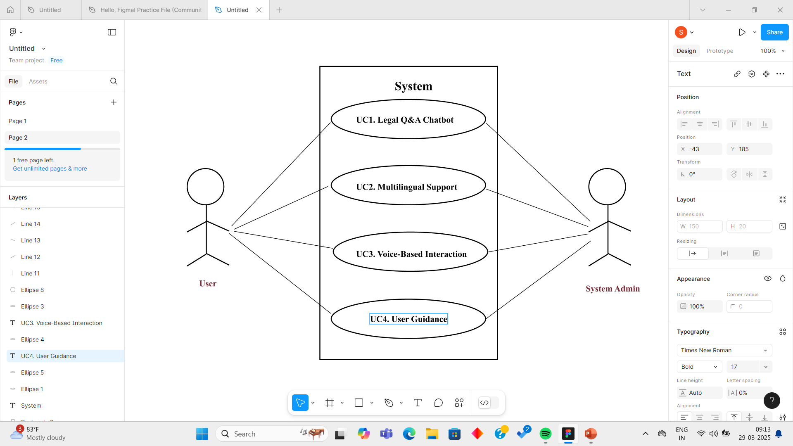
SYSTEM​ DESIGN
USE CASE DIAGRAM

Slide 29
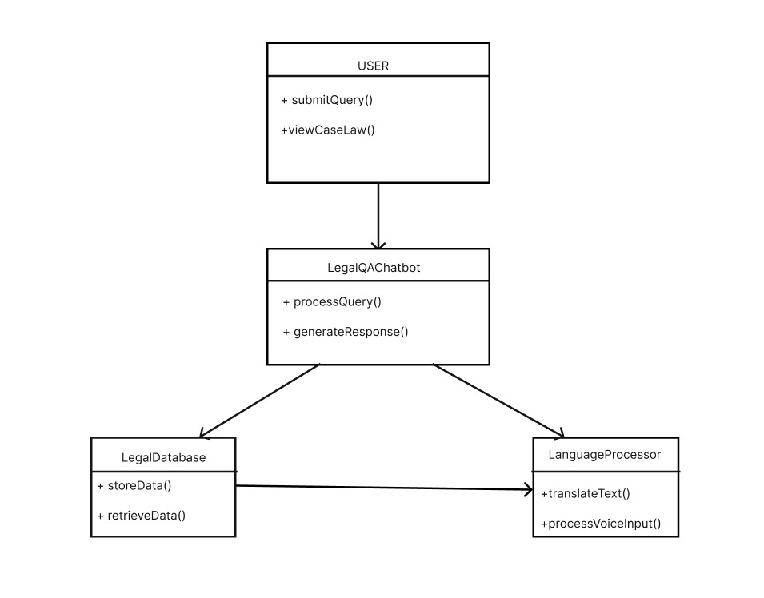
SYSTEM​ DESIGN
UML DIAGRAM

Slide 30
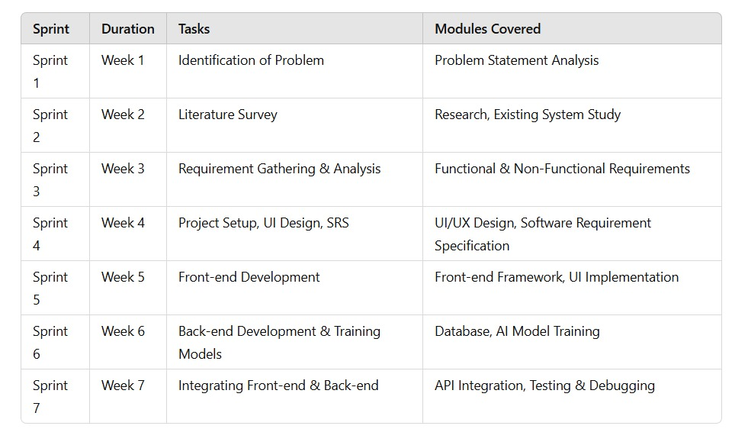
TIMELINE

Slide 31
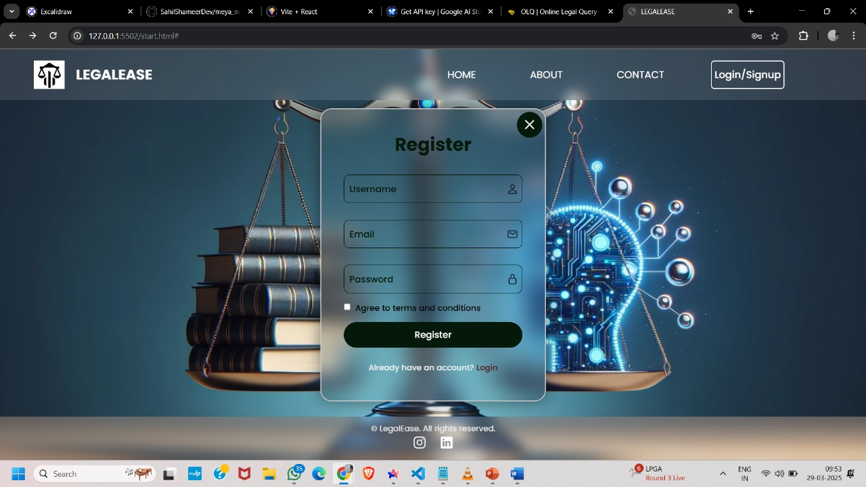
7)MODULE DESCRIPTION​
MODULE 1 : USER AUTHENTICATION
Register using username,email and password

Slide 32
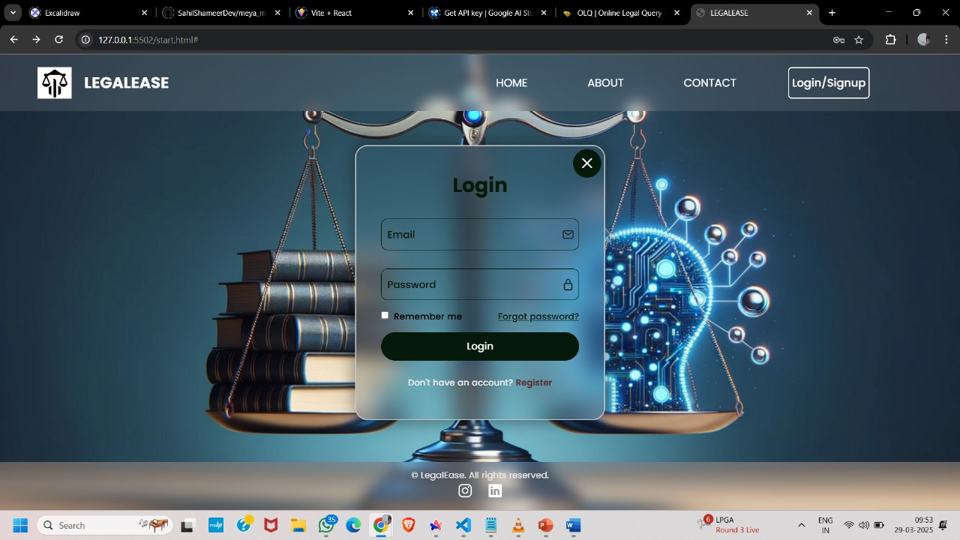
7)MODULE DESCRIPTION​
MODULE 1 : USER AUTHENTICATION
Login using email and password

Slide 33
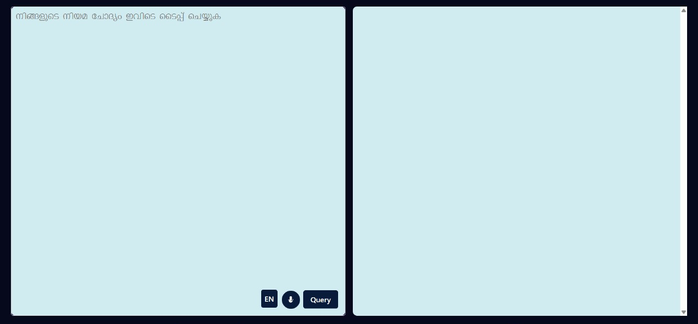
7)MODULE DESCRIPTION​
MODULE 2 : CHATBOT INTEGRATION
The user can input queries in English or Malayalam, either through text or voice.The system processes the query and generates the corresponding output.

Slide 34
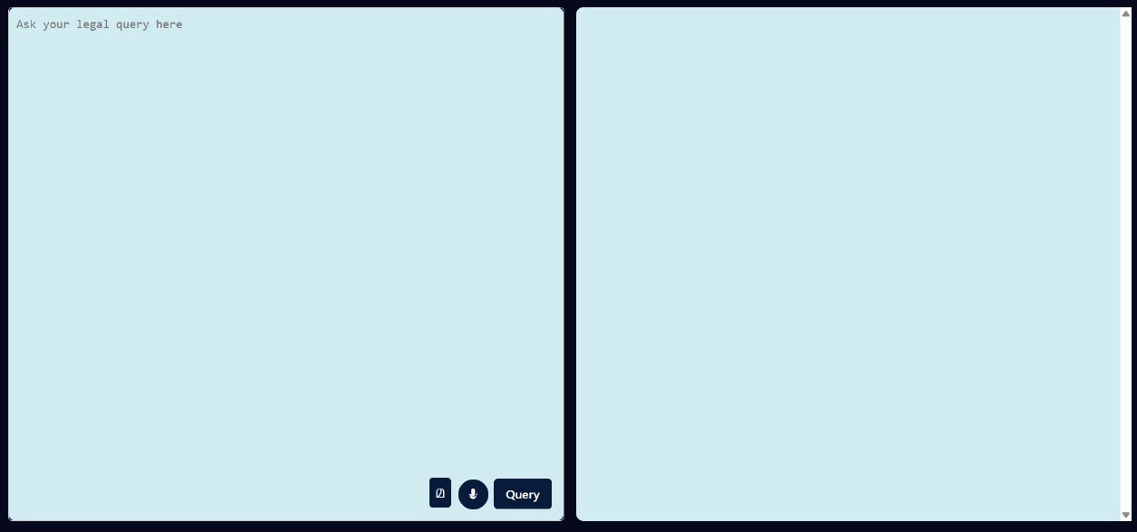

Slide 35
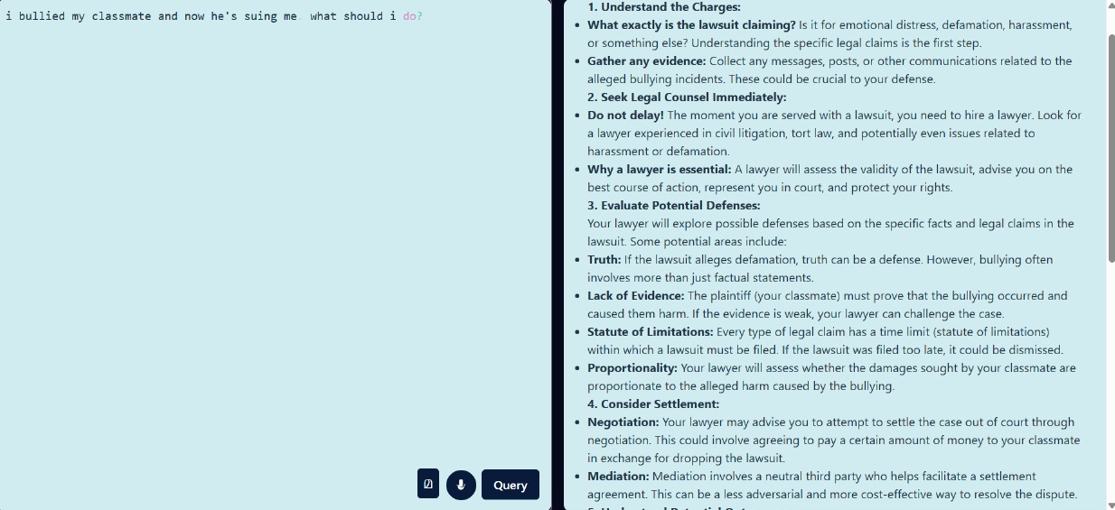
7)MODULE DESCRIPTION​
MODULE 2 : CHATBOT INTEGRATION
The user input appears on the right side, while the corresponding output is displayed on the left side.

Slide 36
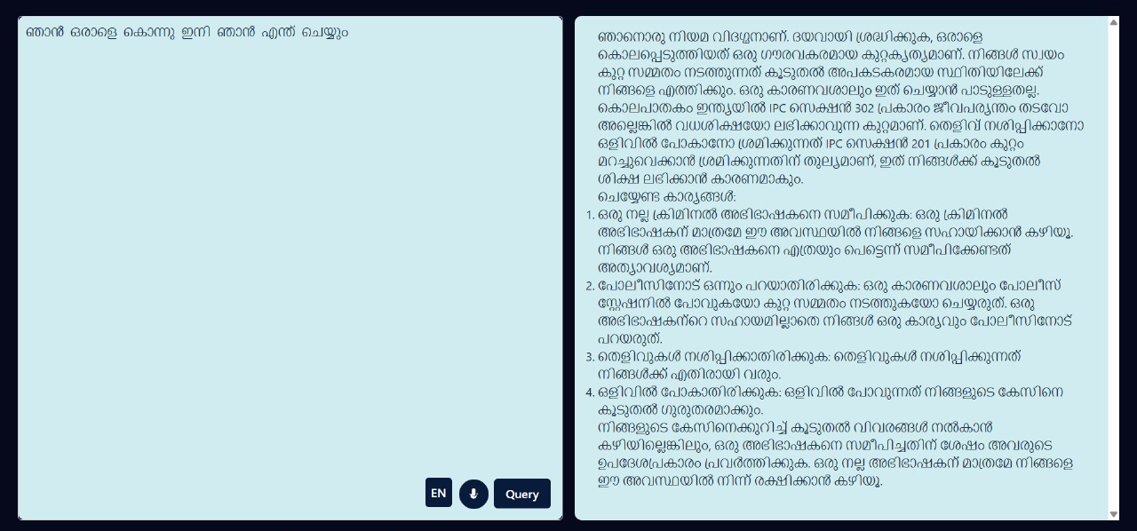

Slide 37
8)IMPLEMENTATION DETAILS​
Frontend
React
Vite
React Markdown & rehype-highlight
Axios
Browser SpeechRecognition API
CSS

Slide 38
8)IMPLEMENTATION DETAILS​
Backend
Node.js & Express
CORS
Dotenv
@google/generative-ai
Internal Modules & Routing
server.js
app.js
ai.routes.js
ai.controller.js
ai.service.js

Slide 39
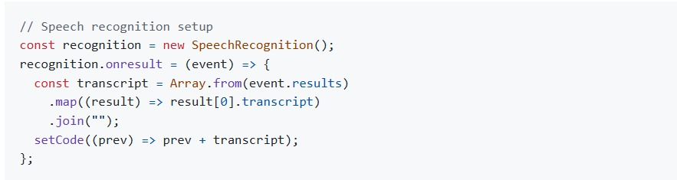
9)RESULT​S AND TESTING
CODE SNIPPETS
1. Speech-to-Text Query Input
Users can input their legal queries via voice, which is converted to text using the browser's SpeechRecognition API.

Slide 40
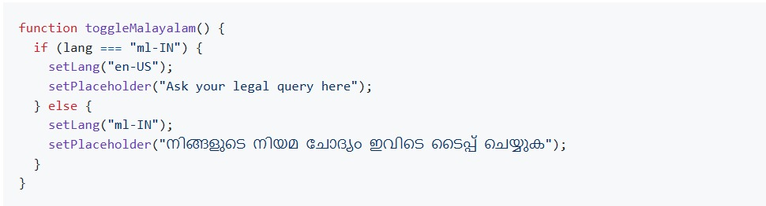
9)RESULT​S AND TESTING
CODE SNIPPETS
2. Language Toggle
Switch between English and Malayalam for query input.

Slide 41
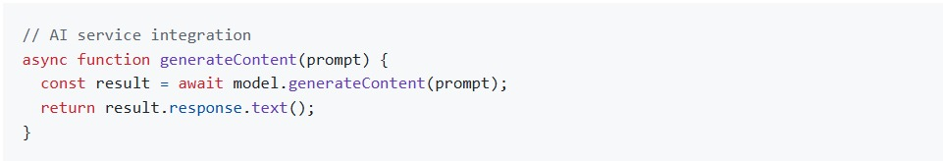
9)RESULT​S AND TESTING
CODE SNIPPETS
3. AI-Powered Legal Query Response
The backend integrates with Google Generative AI to provide detailed legal advice

Slide 42
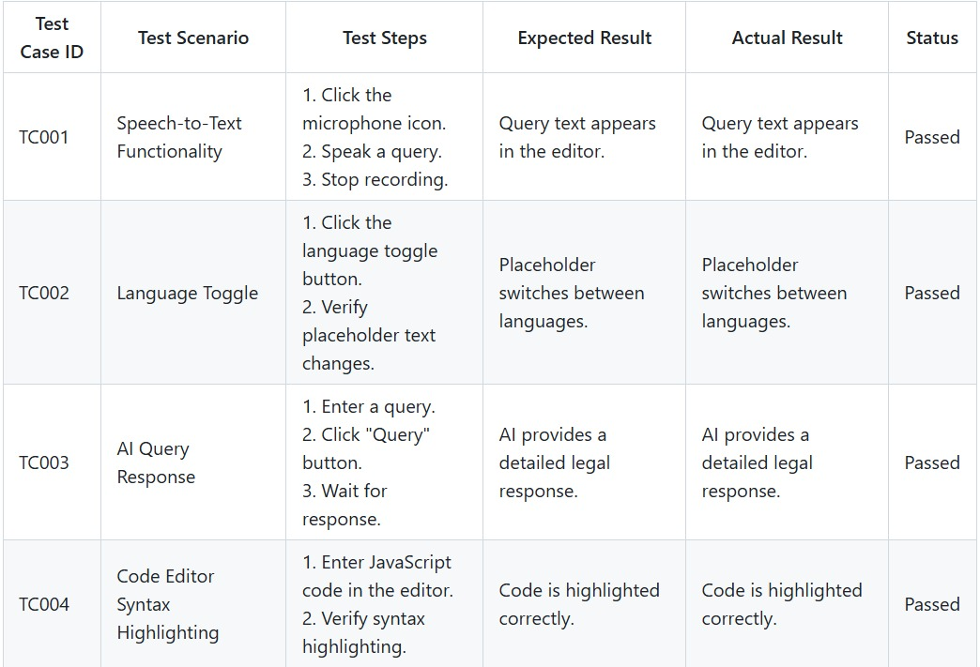
9)RESULT​S AND TESTING
TEST CASES

Slide 43
10)FUTURE SCOPE​
LegalEase has the potential to evolve into a more advanced legal assistance system with several key enhancements:
Integration with Legal Databases – Connecting with government and private legal databases to provide real-time access to case laws and legal documents.
Multi-Language Expansion – Extending support to more Indian and international languages for wider accessibility.
Enhanced AI Capabilities – AI-powered legal assistance, including document analysis, case predictions, and chatbot-based query resolution.
Blockchain for Secure Storage – Using blockchain to store legal documents securely and enable smart contract-based automation of agreements.

Slide 44
10)FUTURE SCOPE​
Advanced Voice and AI Search – Improving voice search accuracy and integrating text-to-speech and speech-to-text for better user accessibility.
Mobile Application – Developing a mobile app for convenient access to legal research and AI-driven assistance.
Court Case Summarization – AI-driven case summarization to extract key legal arguments and judgments efficiently.
Collaboration Tools – A cloud-based platform for legal professionals to collaborate, share documents, and discuss cases securely.
With these advancements, LegalEase can become a comprehensive AI-driven legal research and assistance tool, improving efficiency and accessibility in the legal field.

Slide 45
11)CONCLUSION​
TASK ALLOCATION
MODULE NAME | ASSIGNED TO
Backend, Design Planning, Content Creation | Meya Maria Tony
Dataset Handling, Design Planning, Main Presentor | Gopika Shaju
Backend Planning, Documentation Verification , Design Planning | Sreeya Menon P T
Frontend, Design Planning, Documentation | Sruthy Ravi

Slide 46
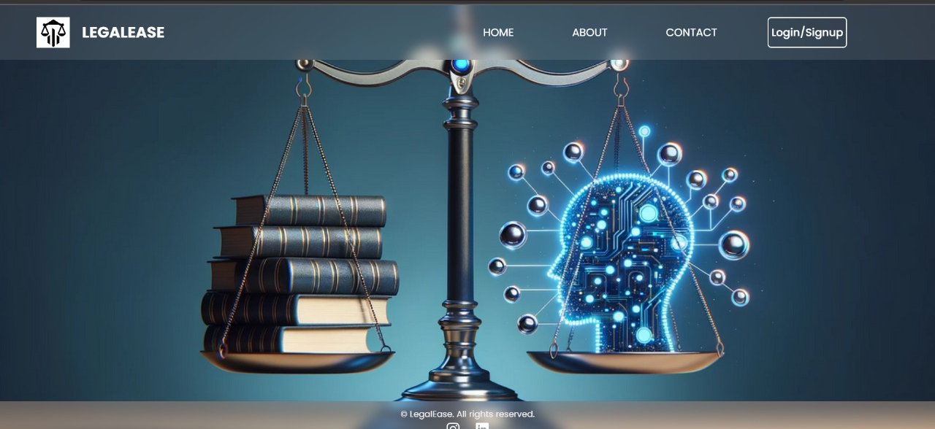
11)CONCLUSION​
SCREENSHOTS

Slide 47
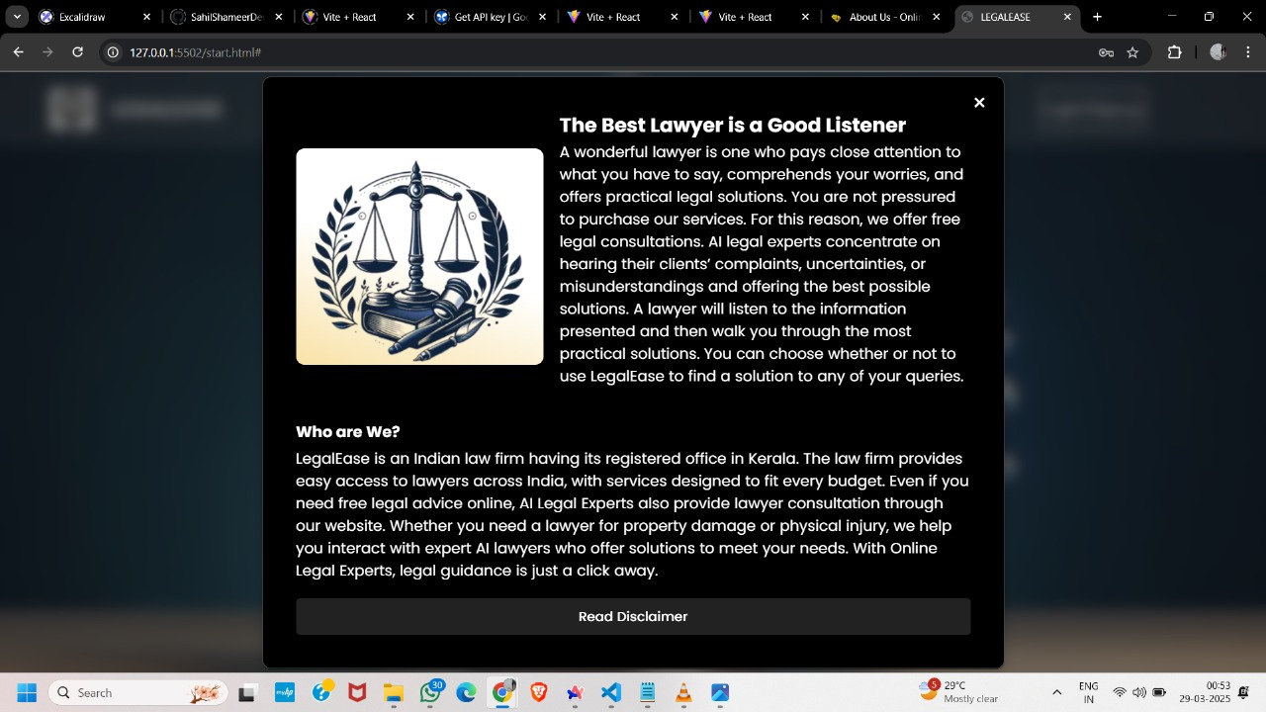
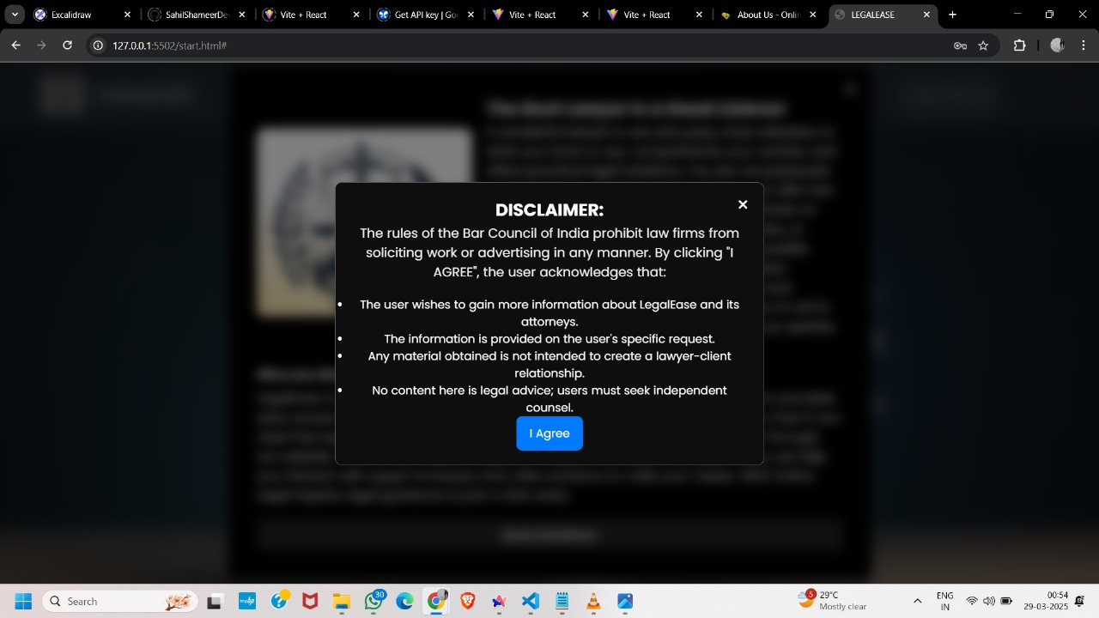
11)CONCLUSION​
SCREENSHOTS

Slide 48
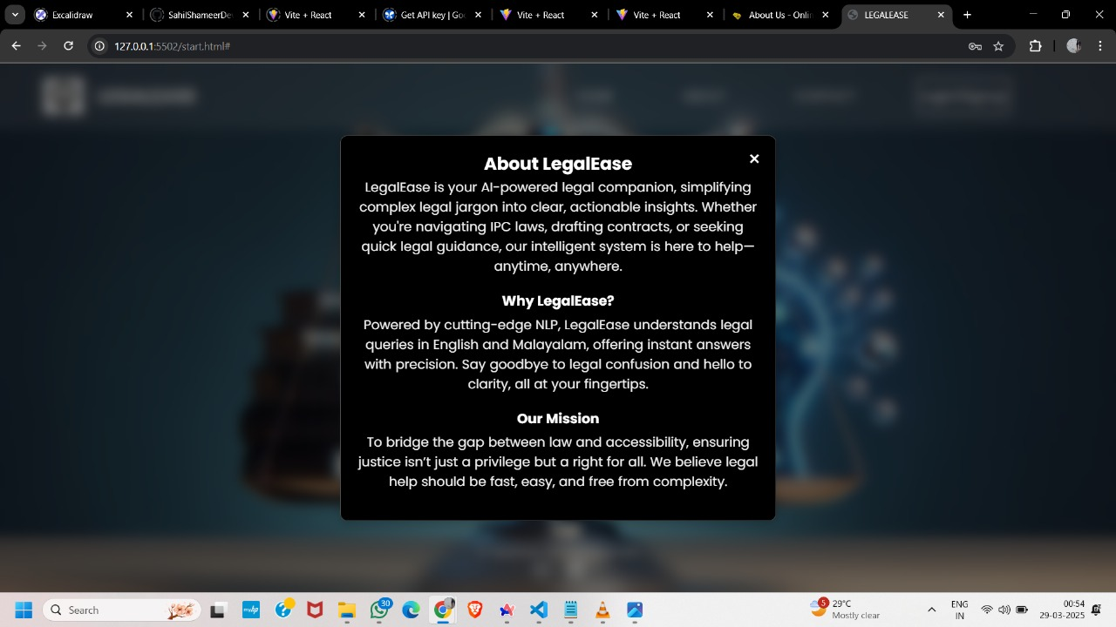
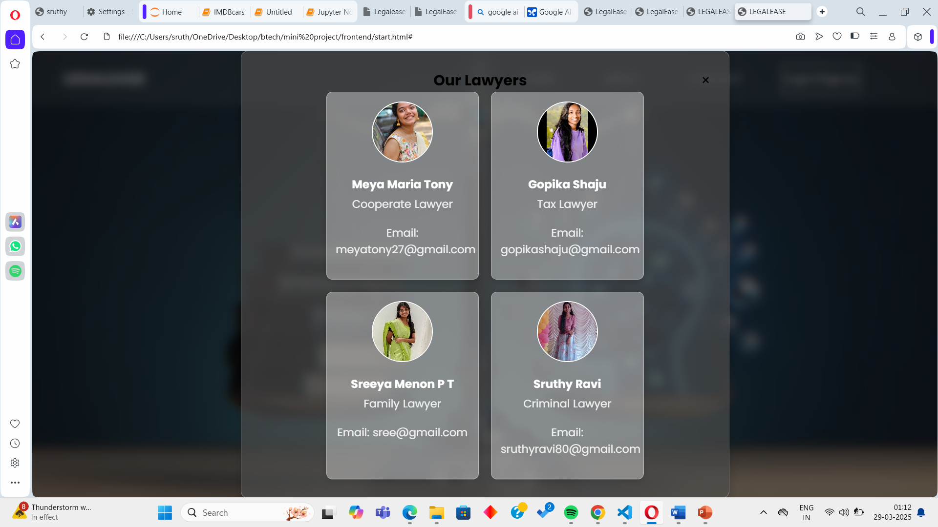
11)CONCLUSION​
SCREENSHOTS

Slide 49
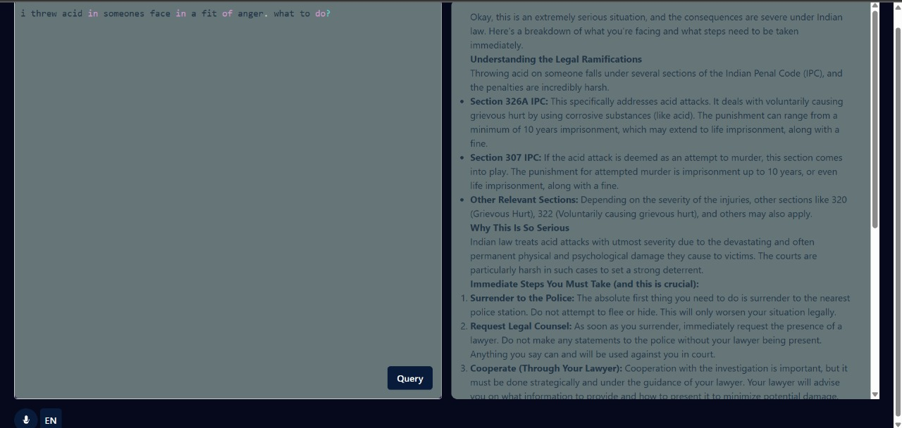
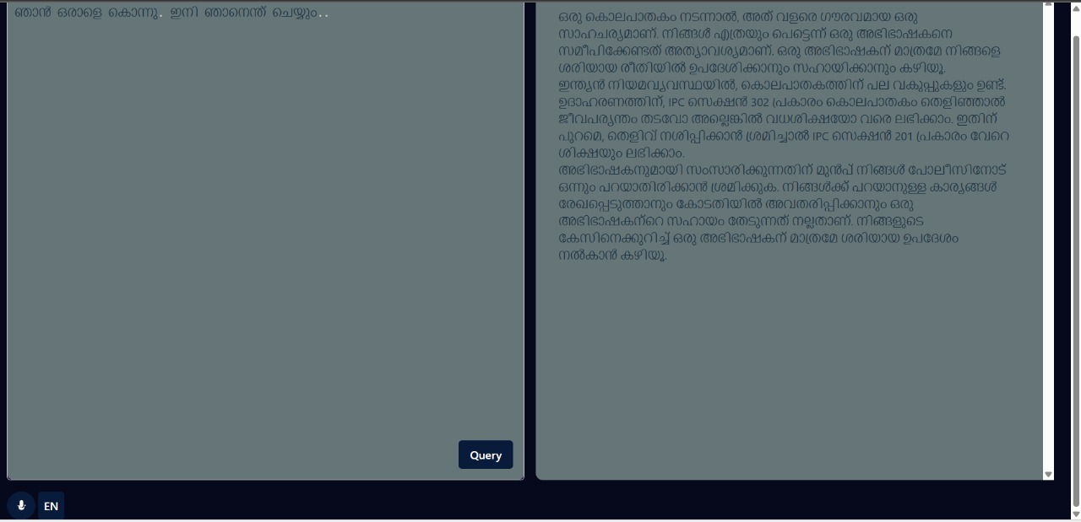
11)CONCLUSION​
SCREENSHOTS

Slide 50
11)CONCLUSION​
The LEGALEASE project aims to revolutionize legal assistance by providing an AI-powered platform that simplifies access to legal information. With features such as natural language processing for legal queries, bilingual support (English and Malayalam), IPC section referencing, voice input, and an intuitive search system, the platform ensures ease of use for both legal professionals and the general public.LEGALEASE will serve as a valuable tool for individuals seeking legal clarity, reducing dependency on manual legal research and making the legal system more accessible to all technology advances, LegalEase can be expanded with blockchain security, advanced AI recommendations, and mobile applications, making it an essential tool for the future of legal research and documentation.

Slide 51
12)REFERENCES
"AI-Powered Chatbots for Legal Assistance" – International Journal of Legal Technology, 2023
"Natural Language Processing for Legal Document Analysis" – IEEE Legal AI Conference, 2024
"Speech Recognition for Legal Queries" – AI & Voice Processing Journal, 2024
"Implementing Bilingual Search Engines for Legal Information" – Language Processing Review, 2023OLQ A online legal query
NyayGuru – Free legal AI chatbot supporting multiple languages (nyayguru.com).
https://play.google.com/store/apps/details?id=com.nyayashodh.app

Slide 52
THANK YOU
Group 15(LegalEase)
CSE B,S6

